Slide 1
Credit EDA Case Study
Anish Gautam

Slide 2
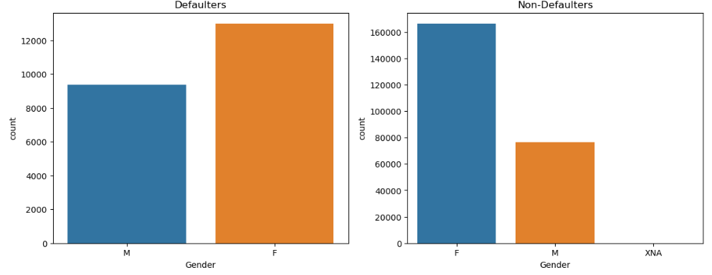
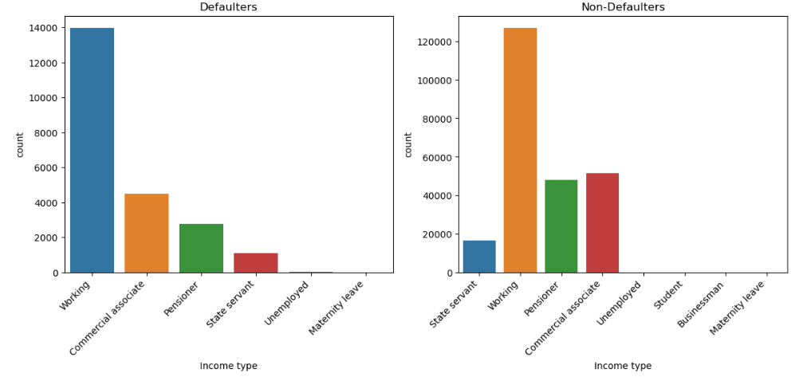
Current applications
Gender-based Observations
Observations:-
The data indicates that the number of male defaulters is lower compared to female defaulters.
The number of female non-defaulters is higher, while male non-defaulters are comparatively lower.
Conduct a comprehensive analysis, combining data by gender and income type, to understand how these factors interact in the context of defaulters and non-defaulters.
Recommendations:-
Understanding the subtle relationships between gender, income and credit behavior is essential to developing targeted and effective solutions.

Slide 3
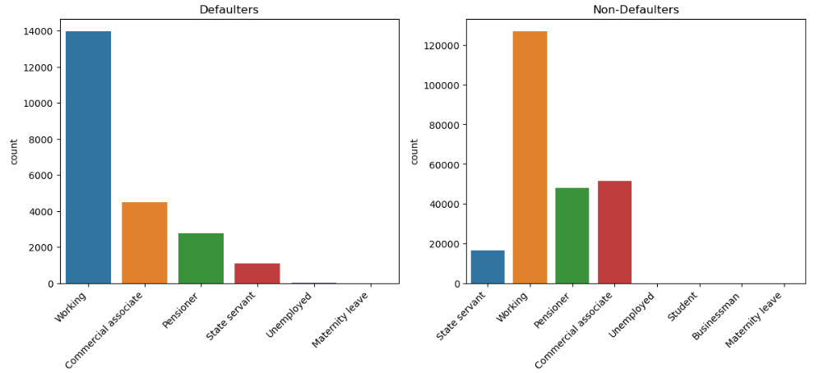
Income groups & age groups
Observations:-
Working people constitute the majority of defaulters, with their numbers significantly higher than other occupations.
Employed individuals make up a substantial portion of non-defaulters, indicating that having employment is associated with a lower likelihood of default.
Recommendation:-
Understanding the specific dynamics of defaulters and non-defaulters within different income types is essential for designing targeted interventions.

Slide 4
Loan application status relations
Current and Previous

Slide 5
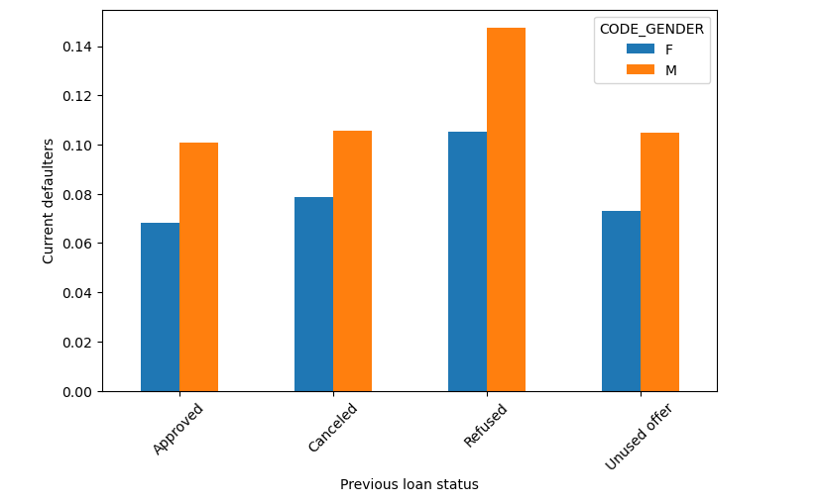
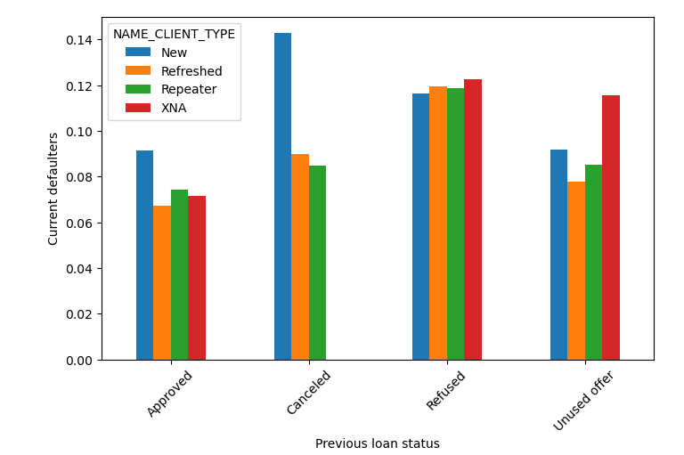
Previous loan status & gender
Previous loan status & client type
Observations:-
Previously refused and unused offer applications by males have a higher default rate. Males with previously refused or unused offers may have specific risk factors or financial behaviors that contribute to a higher likelihood of default.
New clients with previously unused offers also exhibit a higher default rate. New clients with previously unused offers may lack a credit history or have limited financial track records, making them riskier in terms of default.
Focus on providing loans to previously approved females, as they demonstrate a lower risk of default. This can contribute to building a more reliable customer base.
Recommendations:-
Dealing with the chance of not getting paid back needs a careful and smart plan. By paying attention to trends related to gender, making risk assessments better, and giving specific advice, banks can lower risks and create a more lasting way to lend money.

Slide 6
Final note
Highly recommended groups:
Approved Clients with Positive History.
Highly Educated Clients with Higher Income:
Clients with Higher External Source Score: Clients with a higher external source score are considered less risky.
High risk groups:
Previously Refused, Cancelled, or Unused Offer Clients: Clients with a history of refused, cancelled, or unused offers pose a higher risk.
Low-Income Groups with Previous Refusal Status: Low-income clients with a history of refusal are identified as a high-risk group.
Lower Secondary and Secondary Educated Clients: Clients with lower secondary and secondary education levels are associated with higher risk.
Conclusion:
To minimize default risks, prioritize clients with positive credit histories, higher education, and income levels. Exercise caution with clients who have been refused or have low income, and implement thorough risk assessment processes for these groups. Tailor lending practices to acknowledge and address the specific risk factors associated with different client profiles.

Slide 7
Thank you !

